Slide 1
Hello!
Thanks for your interest in telling others about the
MRCT Center Clinical Research Glossary Public Review Process!
This deck is to be used for educational and advertising purposes.
Please do not change any of the links or content.
Please delete this slide when you are ready.

Slide 2
The MRCT Center
The MRCT Center is a research and policy center focused on addressing the conduct, oversight, ethics, and regulatory environment of clinical trials.
Vision
Improve the integrity, safety, and rigor of global clinical trials.
Mission
Engage diverse stakeholders to define emerging issues in global clinical trials and to create and implement ethical, actionable, and practical solutions.
www.mrctcenter.org

Slide 3
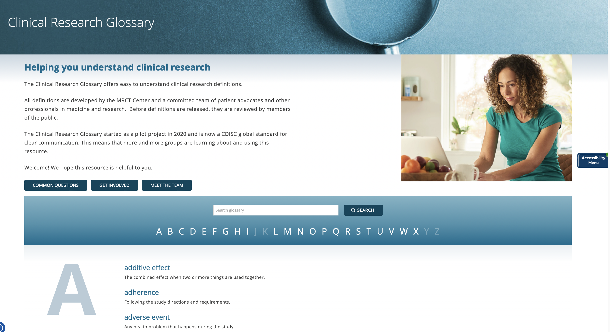
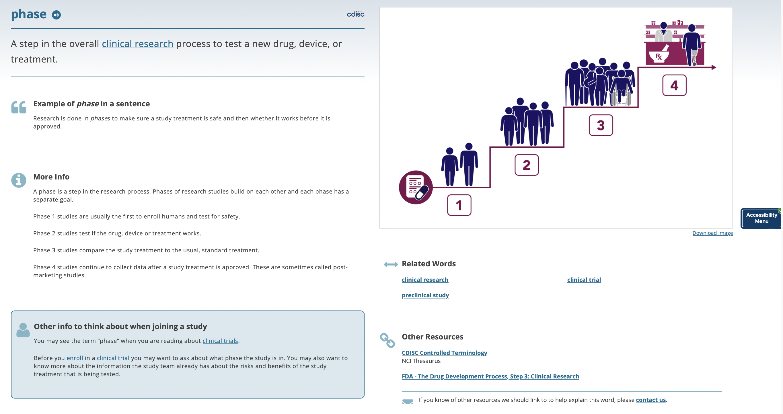
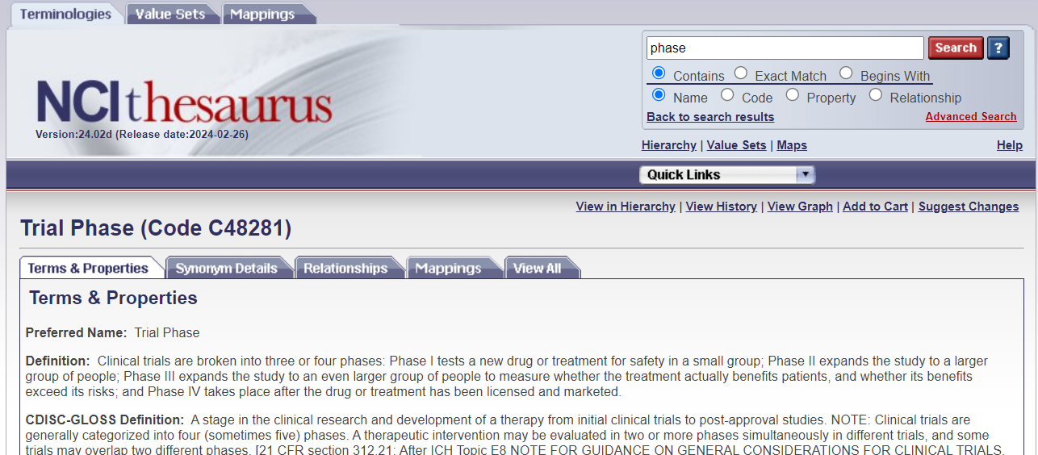
The MRCT Center Clinical Research Glossary
A resource for everyone
www.mrctcenter.org/glossary

Slide 4
The Clinical Research Glossary and CDISC
The MRCT Center Clinical Research Glossary has been included as one of CDISC’s global standards.
This means that the Clinical Research Glossary if governed by a rigorous and robust process to collect public feedback on the definitions that are developed.
All definitions must go through the public review process
The way for this glossary to provide meaningful information is for as many people as possible to take part in the public review process.

Slide 5
2024 Clinical Research Glossary Public Review – opens June 7th!
The MRCT Center Clinical Research Glossary CDISC Public Review
Available June 7th through July 5th.
Twelve (12) definitions up for review.
Access the survey here:
https://redcap.link/publicreview2024

Slide 6
What happens to Public Review feedback
All feedback is transferred into the CDISC Wiki for tracking
Comments are reviewed and addressed by the Clinical Research Glossary team
Transparency is a hallmark of the Public Review process
The reviewer who submitted the comment will receive an email response
The summary of all comments are shared on the public CDISC website
…..The new glossary content is released in September

Slide 7
Help grow The MRCT Center Clinical Research Glossary https://redcap.link/publicreview2024

