Slide 1

Achieving Diversity, Inclusion, Equity
In Clinical Research
Introductory Slides for Stakeholders
Adaptation and Use is permitted with attribution to the MRCT Center

Slide 2

Attribution and Citation
The MRCT Center makes most of its resources free and widely available.
The document Achieving Diversity, Inclusion, and Equity in Clinical Research, the accompanying Toolkit and this introductory slide deck are to be used to promote the values, principles, and content articulated therein. We invite the international research community to use and cite these resources, providing that the source documents and MRCT Center authorship and provenance are expressly and prominently indicates.
Citations for slides:
©MRCT Center https://mrctcenter.org/diversity-in-clinical-research/, with permission, or
Adapted from the MRCT Center https://mrctcenter.org/diversity-in-clinical-research/, with permission
Citation for written materials:
Bierer B.E., White S.A., Meloney L.G., Ahmed H.R., Strauss D.H., Clark L.T., (2021).
Achieving Diversity, Inclusion, and Equity in Clinical Research Guidance Document Version 1.1. Cambridge and Boston, MA: Multi-Regional Clinical Trials Center of Brigham and Women’s Hospital and Harvard (MRCT Center). Available at: https://mrctcenter.org/diversity-in-clinical-research/

Slide 3


The MRCT Center is a research and policy center focused on addressing the conduct, oversight, ethics and regulatory environment for clinical trials.

Slide 4
Aims and Disclaimer
  Aim:
  This presentation was developed for individuals to advance diversity, inclusion, and equity in clinical research. It is intended to be applicable to a wide range of audiences and tailored as necessary for individual and organizational needs.
  Disclaimer:
  The views and findings expressed in this presentation and all associated documents are those of the authors and do not imply endorsement or reflect the views or policies of the U.S. Food and Drug Administration or the affiliated organization or entity of any member who contributed to this work. Individuals have served in their individual capacity.
The MRCT Center is supported by voluntary contributions (www.MRCTCenter.org) and grants.
©MRCT Center

Slide 5
The Case For Diversity in Clinical Research

Slide 6
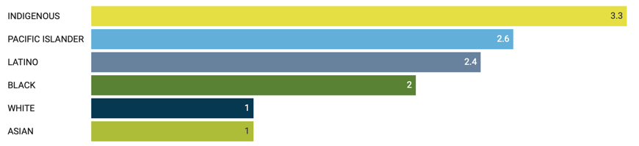



Health disparities by race and ethnicity in the COVID-19 pandemic
Adjusted for age, race and ethnicity widens the gap in mortality compared to Whites
Fold increase
3.3
2.6
2.4
2.0
1
1
3 March 2021
https://www.apmresearchlab.org/covid/deaths-by-race
Evidence exists that groups remain underrepresented in research
https://jamanetwork.com/journals/jama/fullarticle/2769611

Slide 7
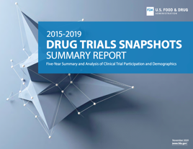
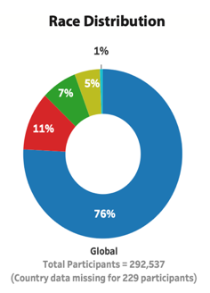
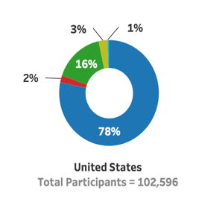
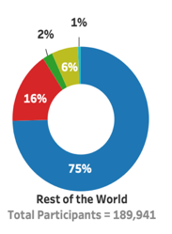
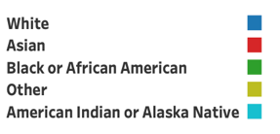
FDA Drug Trial Snapshots: Summaries
Participation of individuals by race in clinical trials globally and the United States, 2015 - 2019
https://www.fda.gov/media/143592/download
But unequally distributed across therapeutic areas

Slide 8
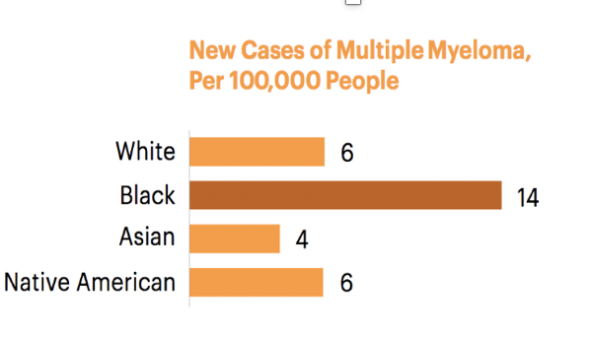
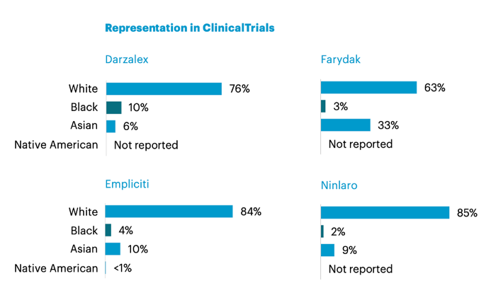
Demographics and Clinical Trial Drug Development: An Example
Black Americans have the highest incidence of multiple myeloma but are significantly underrepresented in clinical trials in trials leading to approval of therapies to treat the disease. In four global drug trials targeting multiple myeloma, the average participation of Black individuals was reported at 5%.
Riley Wong for ProPublica Sept. 19, 2018 citing U.S. Food and Drug Administration; National Cancer Institute
Notes:
Add explanation about clinical trials

Slide 9
Background
Clinical trials are needed to develop new diagnostics, treatments, and vaccines.
Participants in trials should reflect the population affected by the disease or those intended to utilize the intervention, drug, or device.
We should not assume that all individuals respond similarly to interventions.
Underrepresentation in clinical trials of Black, Latinx, Asian, Native American, and other underserved populations—as well as women and individuals at either end of the age spectrum—is not new, persists in both industry and academic trials, and exists across many therapeutic areas.
Race and ethnicity are social constructs, not a biological determinants; social determinants of health, however, have a real impact on biology. In so far as subgroup differences are not examined, potential scientific insights are left unexplored.
Diverse representation in clinical trials is not simply a matter of biology, but a matter of health equity, fairness, and public trust.
Representation is an important principle of generalizable research.

Slide 10
Does it matter?
Approximately 20% of newly FDA approved molecular entities (NMEs) indicated differences in exposure and/or response across racial or ethnic groups that resulted in different prescribing recommendations for specific populations.
CONDITION/ TREATMENT | GEOGRAPHIC /ETHNIC ANCESTRY | SUMMARY
Clopidogrel (Antiplatelet therapy) | East Asians, Native Hawaiians | Genetic expression of cytochrome {CYP} enzyme result in less efficacy of anti-platelet therapies in persons with CYP2C19*2 or CYP2C19*3 allele; frequencies of these genetic variations higher in East Asians, Native Hawaiians, other Pacific Islanders
Carbamazepine (treatment for seizures) | Asians | HLA allele B*1502 marker for Carbamazepine-induced Stevens-Johnson Syndrome and toxic epidermal necrolysis in Han Chinese; high frequency of this allele in many Asian populations; not found in Caucasian patients. FDA recommends genotyping Asians for the allele
Isosorbide dinitrate/hydralazine (Antihypertensive therapy) | Blacks/African-Americans | This treatment of heart failure was indicated as an adjunct therapy to standard therapy in self-identified Black patients to improve survival and improve patient-reported functional status. Retrospective analyses suggested an effect on survival in Black patients but showing little evidence of an effect in White patients.
Ramamoorthy A, Pacanowski MA, Bull J, Zhang L. Racial/ethnic differences in drug disposition and response: review of recently approved drugs. Clinical Pharmacology & Therapeutics. 2015 Mar;97(3):263-73.

Slide 11
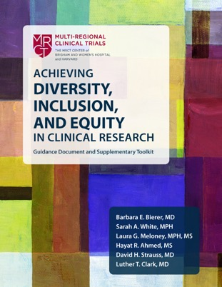

MRCT Center’s Guidance Document:
Achieving Diversity, Inclusion, and Equity in Clinical Research
Multi-stakeholder contributions and consensus
Practical and actionable recommendations
Inclusive of invaluable contributions of >50 workgroup members, representing:
Patients, Patient Advocates
Academia
Pharmaceutical companies
Medical device companies
CROs
Non-profit organizations
Trade associations
Government agencies
Research institutes
Each serving in their individual capacity.
Accountability section considers how each stakeholder can change the paradigm
Toolkit provides adaptable resources not easily found elsewhere
https://mrctcenter.org/diversity-in-clinical-trials/
Notes:
The MRCT Center has prioritized its work to draft and produce a comprehensive guidance document – Achieving Diversity, Inclusion, and Equity in Clinical Research – over the past three years. The MRCT Center convened a large workgroup, consisting of >50 members from Academia, Pharmaceutical companies, CROs, Non-profit organizations, Patients, Patient Advocates, Trade associations, Government agencies, and Research Institutes. The diverse workgroup had guidance from a smaller leadership group inclusive of two FDA representative, a long-standing member of industry, academia and MRCT Center leadership.
The comprehensive Guidance Document and its associated toolkit – released in September 2020 – outlines the case for diversity through social justice, health equity, and scientific pursuit – importantly, it identifies and presents barriers and actionable recommendations to improve diversity in clinical research from an ethical, scientific and practical standpoint. The Guidance Document and toolkit are available for free on the MRCT Center’s website or for purchase on Amazon in hardcopy.

Slide 12
Inclusion and equity in research start with evidence, information, and trust
Data should include those populations affected by the condition or disease and/or those intended to use the intervention being studied.
It starts with building trust through public and community engagement: the process of doing the work is important as is the product of the work.
Clinical trials should:
  address questions of importance to the community
  be designed with study outcomes that people care about
  use language and words that people understand
  be conducted in ways that decrease burden for the participants, and
  communicate results to the communities affected.
Organizations, institutions, and individuals need to hold each other accountable—and help each other be successful—at every stage.

Slide 13
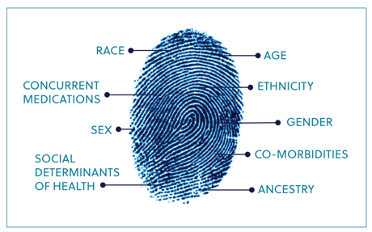
Diversity exists across many dimensions
Diversity requires a broad definition
Race
Ethnicity
Sex
Gender
Ancestry
Age
Social
Determinants
Of Health
Environmental
Factors
Co-
morbidities
Genetics
Concurrent
Medications
Other
Understanding diversity requires an appreciation of intersectionality:
dimensions of diversity are not independent variables.
13

Slide 14
Many factors impact response to interventions and medicinal products

Slide 15
Broadening Engagement

Slide 16
Barriers: Every stakeholder can take responsibility
  Sponsors/Institutions/Sites/Regulators
  Early and authentic engagement with community and others
  Recruit, train, and support a diverse workforce
  Plan for inclusion in trial time and cost/budget
  Navigate differing regulatory expectations and proactively plan for appropriate representation
  Protocol/Trial Designers
  Use best available data standards
  Standardize data collection and reporting to the extent possible
  Provide transparent analyses plans
  Utilize best practices in conduct
  Deploy decentralized and hybrid trials
  Investigators/Referring Physicians/ Staff
  Help define scientific utility of inclusion
  Refine eligibility criteria to those scientifically or ethically justified
  Provide accurate site feasibility assessments
  Plan for adequate staffing and time
  Develop recruitment and retention strategies
  Provide cultural competence and implicit bias training for all staff
  Patients/Advocates/Communities
  Improve awareness
  Seek access
  Request study design and research procedures be less burdensome
  Provide input on logistics of trial conduct
  Speak about mistrust
Notes:
Pain points – or barriers to inclusion and appropriate representation – exist for all stakeholders in the clinical research enterprise. There isn’t a single starting place – it will require the commitment of all stakeholders to work individually and collectively toward the shared goal.

Slide 17

Change requires engagement with participants, the community and the public
SOCIETY/POLICY
COMMUNITY
Community
Engagement
HOSPITALS,
SPONSORS,
INVESTIGATORS,
INSTITUTIONS,
SITES
PUBLIC
PARTICIPANTS/
CAREGIVERS
PATIENTS
Access, Awareness, Knowledge
Workforce
Development
Notes:
Each research study or clinical trial is context specific; but all research studies should embody a holistic approach that considers the intersecting spheres of influence on the outcomes and success of the study. Stakeholders are encouraged to think about all of the influences that exist– the patients, their caregivers and family, the workforce, the institution or organization, the community and the public – rather than approaching them in silos or as independent functions of each other.

Slide 18
Patient and community engagement support diverse participation
The patient and community to be in key leadership roles,
as advisors, and as consultants.
Form Relationships
Provide Training and Support
Patient perspective to influence research priorities and questions
Seek input to tailor study design and conduct to improve access, enrollment, and retention
Identify Shared Goals
Trust and trustworthiness

Slide 19
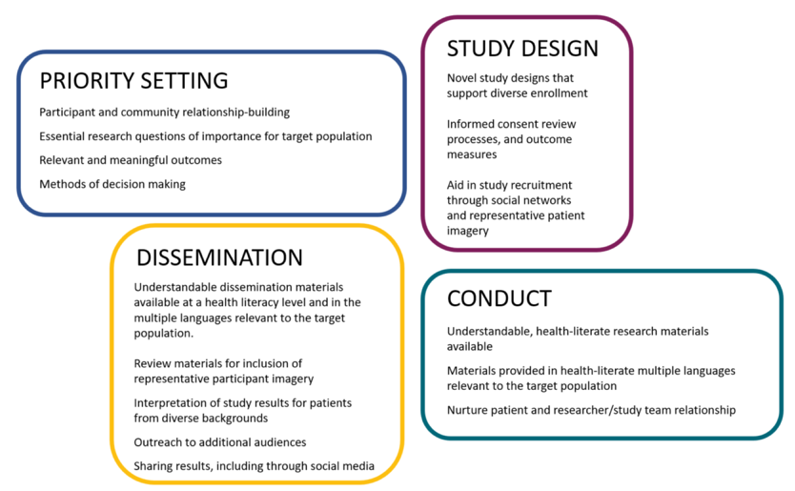
Participant engagement across the clinical trial

Slide 20
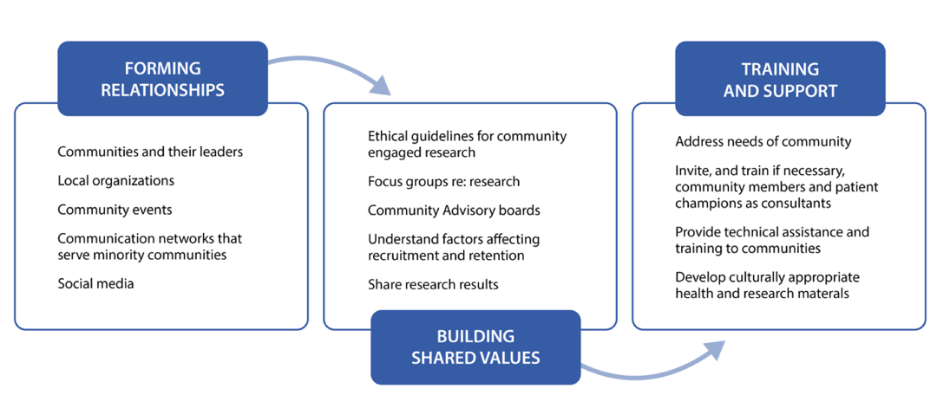
Process, approach, and strategy for community engagement

Slide 21
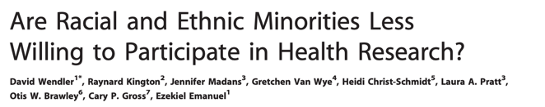
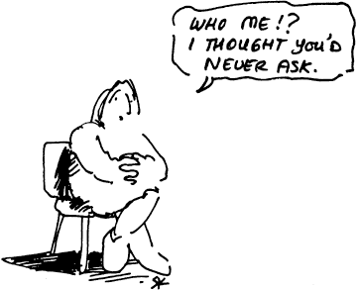
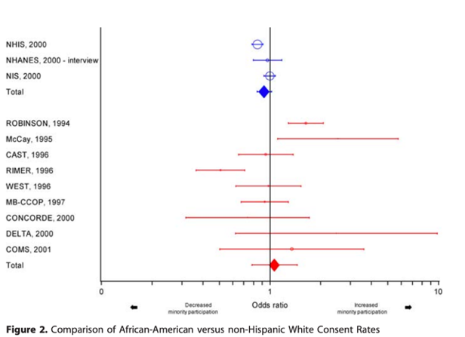
Individuals must be invited
From: http://www.aral.com.au/ari/p-ywadsworth98.html
Blue indicates interview and non-intervention studies; red indicates clinical intervention studies. The graph indicates that most studies found that African-Americans were equally willing to participate in research as non-Hispanic white
DOI: 10.1371/journal.pmed.0030019.g002
©MRCT Center
Notes:
A central issue to the problem of diversity and representation in clinical research is that not all individuals are invited equally.
There is a general belief that underrepresented populations are less willing to participate in clinical research; that belief is unsubstantiated by the evidence available. Wendler and colleagues performed a comprehensive literature search to identify consent rates reported by race and ethnicity. Studies representing over 70,000 individuals demonstrated that the decision to participate in clinical research was equal between African American and non-Hispanic White.

Slide 22
So why are some people not asked?
Education
Access
Accessibility
Referral, if necessary
But in academic centers, often because the investigator or their study team never asks.
  ”They would have trouble attending appointments.”
  “They don’t have a stable living environment.”
  “It’s too far to travel.”
  “They have children at home”
  ”They might not complete the study.”
Identified Areas of Bias
Age
Disability
Education
English language proficiency and fluency
Ethnicity
Health status
Disease/diagnosis (HIV/AIDS)
Insurance
Obesity
Race
Socioeconomic status (SES)
Sexual orientation, gender identity, or expression
Substance use (injection drug user) and
Social contact (investigator contact with patient populations)
Other
Implicit bias and cultural competence training
may help to promote awareness and self-reflection

Slide 23
Study Design, Conduct, and Implementation

Slide 24
Introduction to the patient journey
Every touch-point has impact
Early Interventions
End of Study, Data Analysis, and Reporting
Study Conduct
Recruitment
Informed consent: Participant on study
Participant Last visit:
End of study treatment
End of trial
LPLV
Data Analysis Complete and Reporting
Access
Data
Lock
Screening
On-Study visits
On study:
Additional testing
Randomization
Follow-up period
Awareness

Slide 25
What can we do to alleviate burden and plan for inclusion?
Early Interventions
End of Study, Data Analysis, and Reporting
Study Conduct
Patient & Community Engagement & Outreach
Education & Health Literacy
Eligibility Criteria
Feasibility Assessment
Targeted recruitment materials and plan
Logistical issues (e.g., advertising locations, material translations, screening site locations)
Referring physician engagement
CRO/ARO/CC choice, expectations, and contracting issues
Site selection and support
Participant navigators and cultural ambassadors
Planning of the clinical trial essential for success—at cost and on time
Recruitment
Informed consent: Participant on study
Participant Last visit:
End of study treatment
End of trial
LPLV
Data Analysis Complete and Reporting
Access
Data
Lock
Screening
On-Study visits
On study:
Additional testing
Randomization
Follow-up period
Awareness

Slide 26
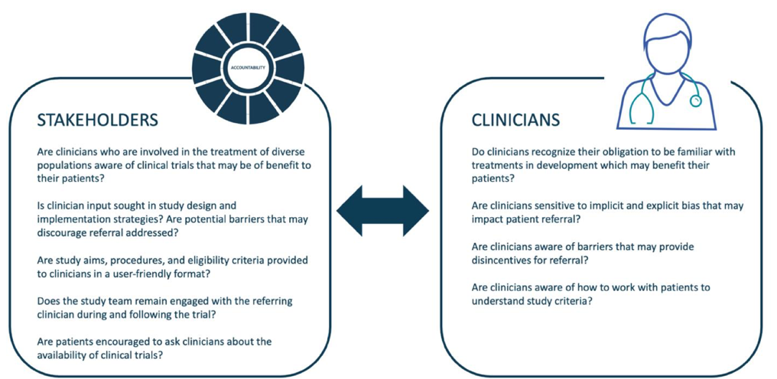
Community awareness includes healthcare providers

Slide 27

What can we do to alleviate burden and plan for inclusion?
Study Conduct
Study design
Decentralized and hybrid clinical trials
Mobile Health technologies
Informed consent simplification
Health literate, culturally- sensitive and linguistically appropriate communications
Logistical issues (e.g., visits, payment, transportation, childcare, extended clinic hours)
Standardized data collection
Continuous education, support, and outreach to participants and their communities
Participant navigators
Continuous learning and improvement
Informed consent: Participant on study
Participant Last visit:
End of study treatment
End of trial
LPLV
On-Study visits
On study:
Additional testing
Randomization
Follow-up period

Slide 28
Trial planning
Detailed understanding of process, steps, responsibilities, and accountability to design and implement potential interventions
Study Design
Fit for purpose, epi & burden of disease
Inclusive of and engaged populations
Optimize design
Minimize burden
Study Question
Social and scientific value
Resonance with affected population
Representing the impacted populations
Interdependent relationship(s)
Eligibility Criteria
Feasibility Assessments
Geophysical mapping
Aggregate population plans
Product/study recruitment plan
Informs site selection
Homogeneity vs heterogeneity of treatment effect
Scientifically or ethically justified
Site Selection and Support
Capacity for diverse enrollment
Set expectations, communications
Data-driven metrics
Performance tracking

Slide 29
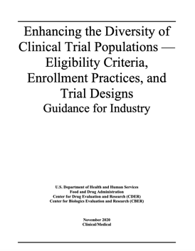
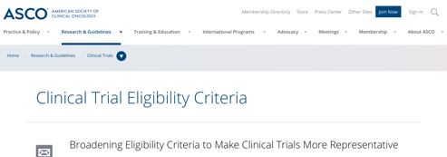
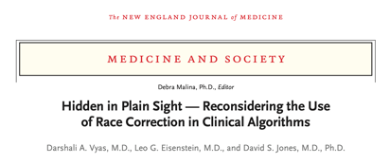
Eligibility Criteria
Study design influences eligibility criteria; Adaptive trials allow progressive modifications in eligibility consistent with safety data Exclusion criteria: objective and scientifically or ethically justified Justification should be reviewed by oversight committees (IRB, DMCs). Eligibility criteria should be as broad as possible and as narrow as necessary. When there is strong prior evidence of heterogeneity of treatment effect, eligibility criteria should be broad—or advertently broadened at an appropriate time—to include desired subgroups in the product development and evaluation.

Slide 30


Clear communication is a shared responsibility
It is not that the listener has “poor literacy.”
The communicator is responsible for sharing information that is understandable to the listener.
The listener should be comfortable communicating any lack of understanding
Plain language
Numeracy
Visualization
Clear design
Cultural considerations
Interactive techniques
Teach-back
Written Materials
Verbal Communications
https://mrctcenter.org/health-literacy/
Notes:
You all, I think, know this intuitively:
In order to really communicate effectively one has to move beyond the traditional definition of health literacy being a solo endeavor comprised of a person’s ability to understand and use information to make decisions about their health (or in our situation, about whether to be in a clinical research study)….
To a relationship that acknowledges the responsibility of the communicator to ensure that the information being shared is designed to be understood by the target audience.

Slide 31
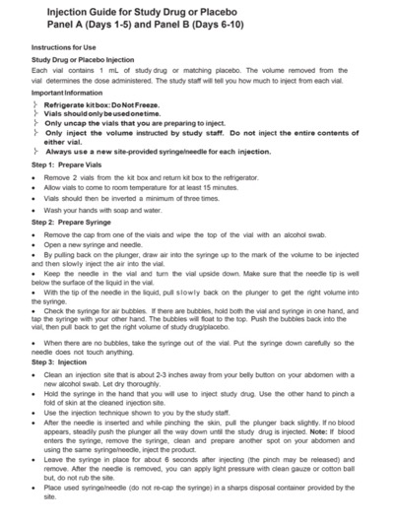
Health literacy beyond the ICF
https://mrctcenter.org/health-literacy/

Slide 32
Characteristics of traditional and innovative clinical trials
Traditional Clinical Trials
Hybrid Trials
Decentralized Clinical Trials
Visit to site required
In-person visit or hospital stay
On-site imaging or research procedures
Prolonged monitoring and observation
PK, PD studies
  Some virtual visits allowed
    Telehealth visits
    Visiting nurse
    Visiting phlebotomist
    Online or mobile applications
    Wearable sensors
Virtual visits only
Use of mobile technologies and telehealth only
Remote and eConsent
Wearable sensors
Online or mobile applications
Functional characteristics
On-site data capture
In-person data capture
In-person instruction and oversight
Appointment flexibility
Extended hours
Availability of elder & childcare
Reimbursement for expenses
Transportation arrangements
Data privacy and security
Both on-site and remote data capture
On site data capture
Participant convenience
Time and burden reduction
Equity to access
Data accuracy, data integrity
Data privacy and security
Remote data capture
Direct-to-patient supply and delivery
Logistical flexibilities
Convenience
Technological requirements
Data accuracy, data integrity
Data privacy and security
Operational characteristics
Notes:
For Study Question & Conduct
See how it fits into text
Indicate more/less patient burden across?

Slide 33
What can we do to alleviate burden and plan for inclusion?
End of Study, Data Analysis, and Reporting
Standardize results reporting
Post-trial access to medicines
Clarity around end-of-study expectations and communications
Return of results to participants, the community, and the public, in health literate, culturally sensitive, and linguistically appropriate communications
Implementation assistance if possible
Data Analysis Complete and Reporting
Data
Lock
https://mrctcenter.org/diversity-in-clinical-research/ with permission

Slide 34
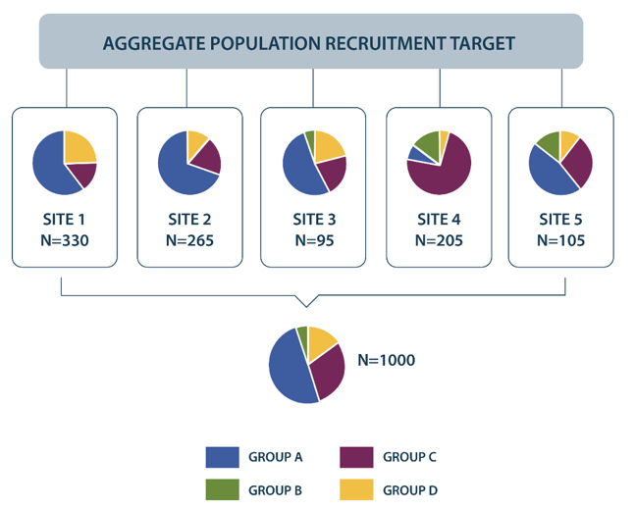
Multi-site trials aggregate site data
In a multisite trial, each site contributes to the final distribution of subgroups.
Site recruitment is often unevenly distributed, both in number and subpopulation.
Typically, no single clinical trial is determinative in drug development and research
Each clinical trial contributes to and advances knowledge
Across sites, trials, and time, data can be aggregated.

Slide 35
Tools and resources
The MRCT Center developed a suite of tools to be adopted and adapted to a stakeholders’ needs. Below is a short-list of tools and resources that can help transpose recommendations into reality.
Patient & Community Awareness, Access and Engagement
Study Design, Site Selection & Feasibility
Study Conduct
Accountability
Logic Model – Community and Participant Engagement
Checklist – Participant Engagement Strategies
Awareness Raising Initiatives
Logic Model – Study Design
Feasibility Decision Tree
Site Selection KPIs
Data Variables Tool
Logic Model – Workforce Development
Screen Failure Tracking Log
Model– Study Design
Recruitment Strategy Document
Accountability KPIs
Logic Model – Accountability
Checklist – Diversity and Inclusion Organizational Strategies

Slide 36
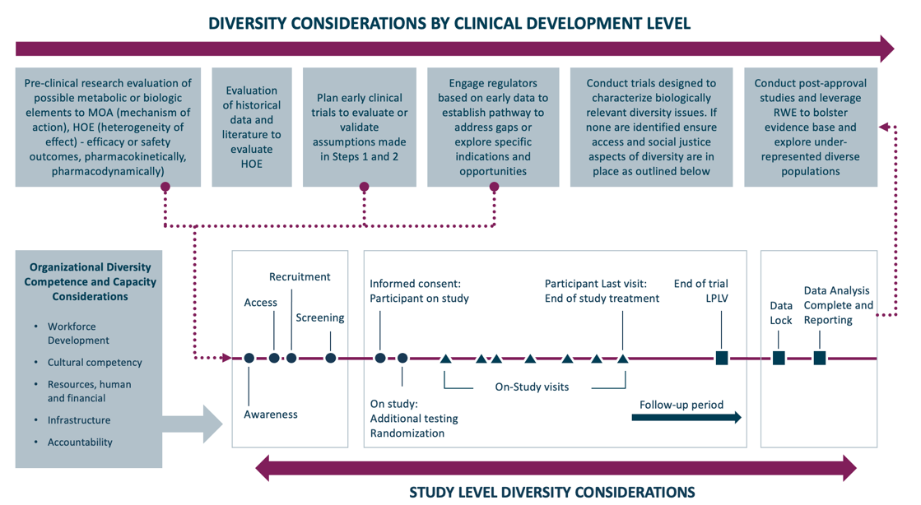
Diversity and inclusion considerations extend beyond a single study

Slide 37
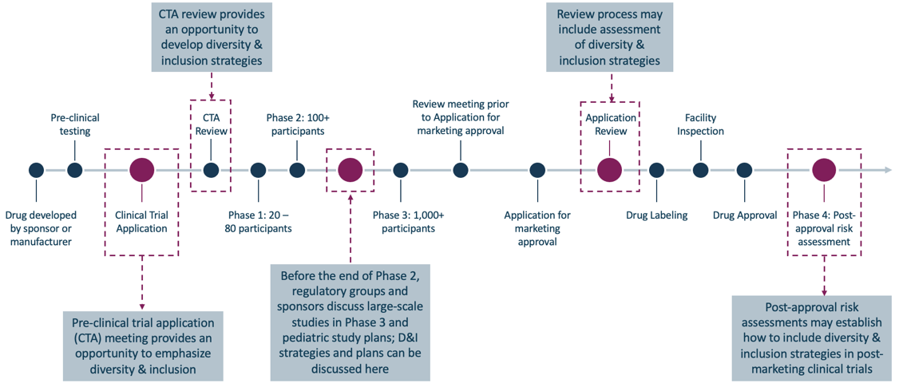
Interactions with health regulatory agencies are key

Slide 38
Accountability, Commitments, and the Future

Slide 39
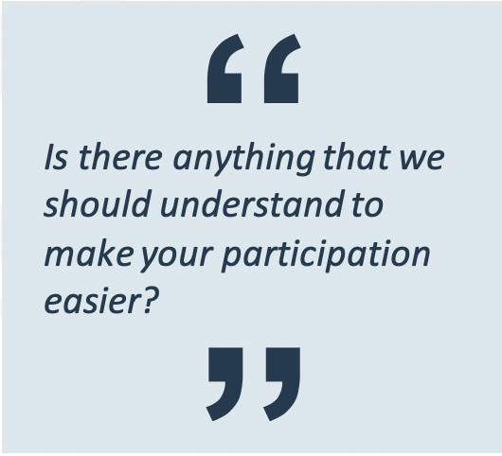
Key Areas for Current and Future Actions
Improve workforce diversity
Create common data standards for collection and reporting
Consider novel data analytic approaches
Diversity in Genetics Databases
Utility of real-world evidence and post-approval studies
Metrics and tracking
What can we understand about you to make your participation easier?

Slide 40
Clinical Research Workforce Development
Inclusive of…
Clinicians
Investigators
Research team members
Referring physicians
Sponsors
CROs
Patient recruitment vendors
Participant navigators
…anyone who is directly or indirectly involved in the research study
Expectations of the work
Sensitizing the clinical research workforce to issues of diverse participation
Building the number of underrepresented minority investigators and study staff
Providing cultural competence and implicit bias training of all staff
Supporting diversity with health literacy and clear communication
Involving physicians in community healthcare settings and ensure they understand clinical research

Slide 41
Minimum expectations of workforce development
Inclusive of
Clinicians
Investigators
Research team members
Referring physicians
Sponsors
CROs/AROs
Patient recruitment vendors
Participant navigators
Invest in
Talent development
Training
Workforce Development
Commitment to health literacy
Training research professionals, staff, and others in cultural and linguistic competency
Commitment to recruiting and training a diverse clinical research workforce
Implicit bias training and respect of potential populations
Assessments and improvements should be data-driven, tracking predefined metrics.

Slide 42
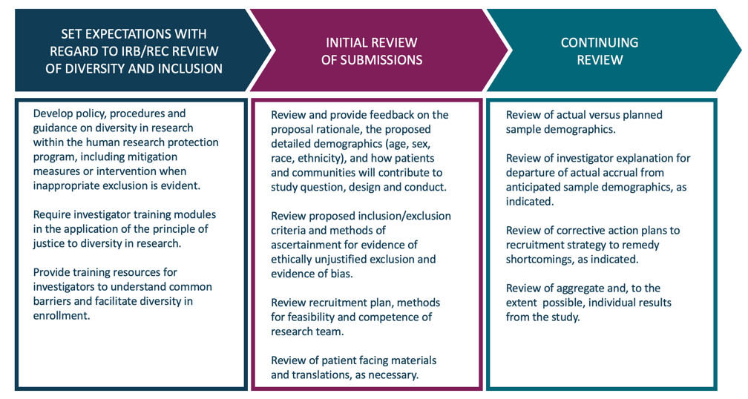
Role of the IRB/REC in promoting diversity and inclusion

Slide 43
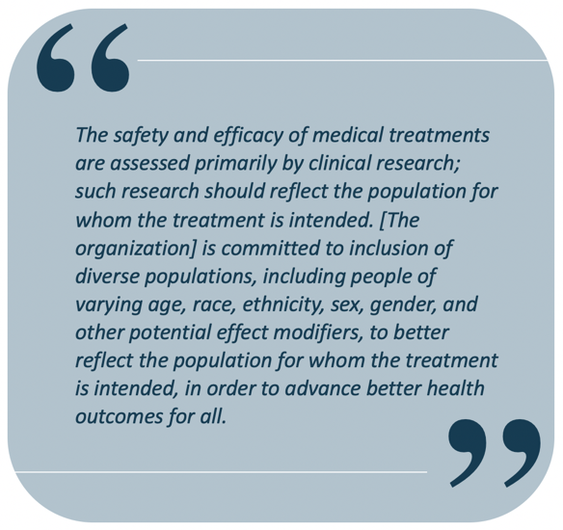
Public Commitment to Diversity in Clinical Research
Organizations should develop a model statement of commitment
Statement can be aspirational (e.g., “…working towards inclusion”) and modified as progress occurs
Ahmed HR, Strauss DH, Bierer BE. Committing to the Inclusion of Diverse Populations in Clinical Research. Therapeutic Innovation & Regulatory Science. 2020 Jan 2:1-3.

Slide 44
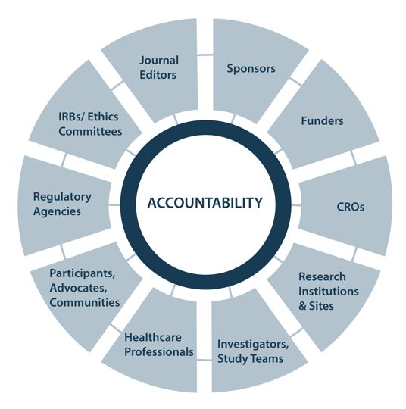
Accountability in Partnership
Hold all stakeholders accountable
Metrics
Transparency
Dialogue
Notes:
NOTE: This slide shows stakeholders involved in the clinical research enterprise who should be held accountable for making progress and change in inclusion and diversity in clinical research. HOW this is achieved by each stakeholder will need to be explored and stipulated by whomever is leading this conversation – each stakeholder should brainstorm efforts they can take to make progress. Please refer to Part F: Stakeholder Commitments and the Future in the Diversity Guidance document (https://mrctcenter.org/diversity-in-clinical-trials/) for suggestions and recommendations.

Slide 45
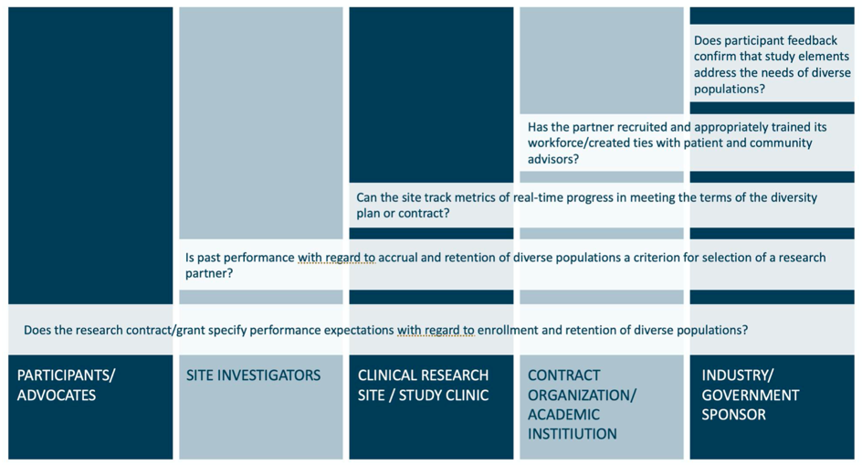
Accountability in Partnership

Slide 46
The work ahead
What can each of us do now?
  Committing to inclusion is our first step.
Establish baseline(s) – what is the current reality and what is our strategy?
  Standardize collection and reporting of critical demographic and non-demographic variables
  Determine what is most impactful and feasible – internally and externally – to make change
  Regular internal and external organizational reviews for inclusion and equity
Expand local, national, and international focus moving forward
mrctcenter.org/diversity-in-clinical-trials

Slide 47
Where to start?
Current state
Inclusion (and risks of exclusion)
Equity
Map the goal
Leadership: culture, example, and expectations
What you can measure, you can change
Systematic education and system expectations
Steady commitment, for the marathon not the sprint
Willingness to course correct
Coordination and cooperation
“…the real work of change is done year by year, month by month, and day by day, by all of us, by each of us…”

Slide 48
Thank you
We look forward to hearing from you. Comments and suggestions are welcome
MRCTCenter@bwh.harvard.edu
For more information on the MRCT Center Diversity in Clinical Research project, please visit: https://mrctcenter.org/diversity-in-clinical-research/

